Slide 1

Imaging and Analysis of Post-processing for Discrete Element Method and its Application
Algorithm Description
Numerical Simulation Experiment
Nanjing University
WEI Huajing
22/06/2020

Slide 2
Content
Introduction
Algorithm
Example
Experiment
Conclusion

Slide 3
Content
Introduction
Algorithm
Example
Experiment
Conclusion

Slide 4
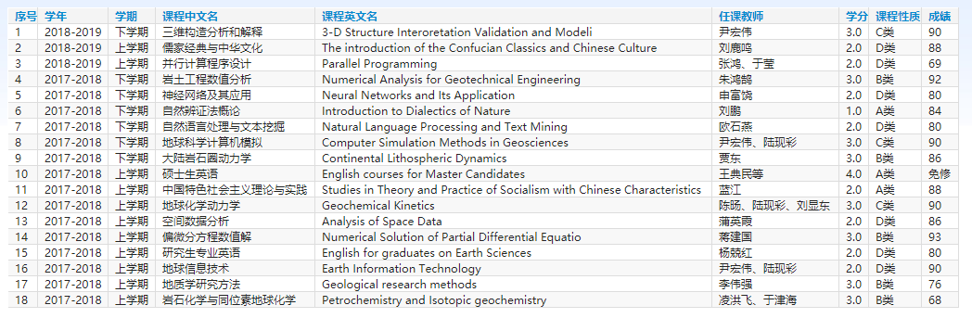
Curriculum
18 courses for 45 credits

Slide 5
Workload
Python Code for Post-processing algorithm: 56172 lines
2D Compression Structural Experiment: 53 sets
Structural Deformation and Feature Map Figures: 5724 pieces

Slide 6
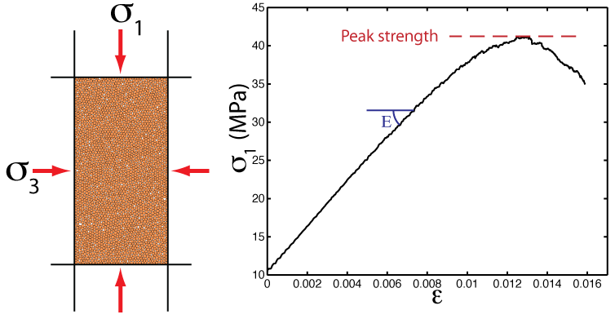
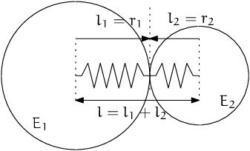
Background
DEM: Discrete Element Model
Micro-granular system for macroscopic object
Based on Newtonian mechanics
Masses of computation

Slide 7
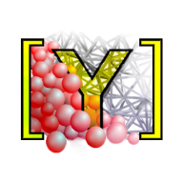
Software
YADE: Yet Another Dynamic Engine
Performed on Linux
Open Source
Python Command Line

Slide 8
Content
Introduction
Algorithm
Example
Experiment
Conclusion

Slide 9

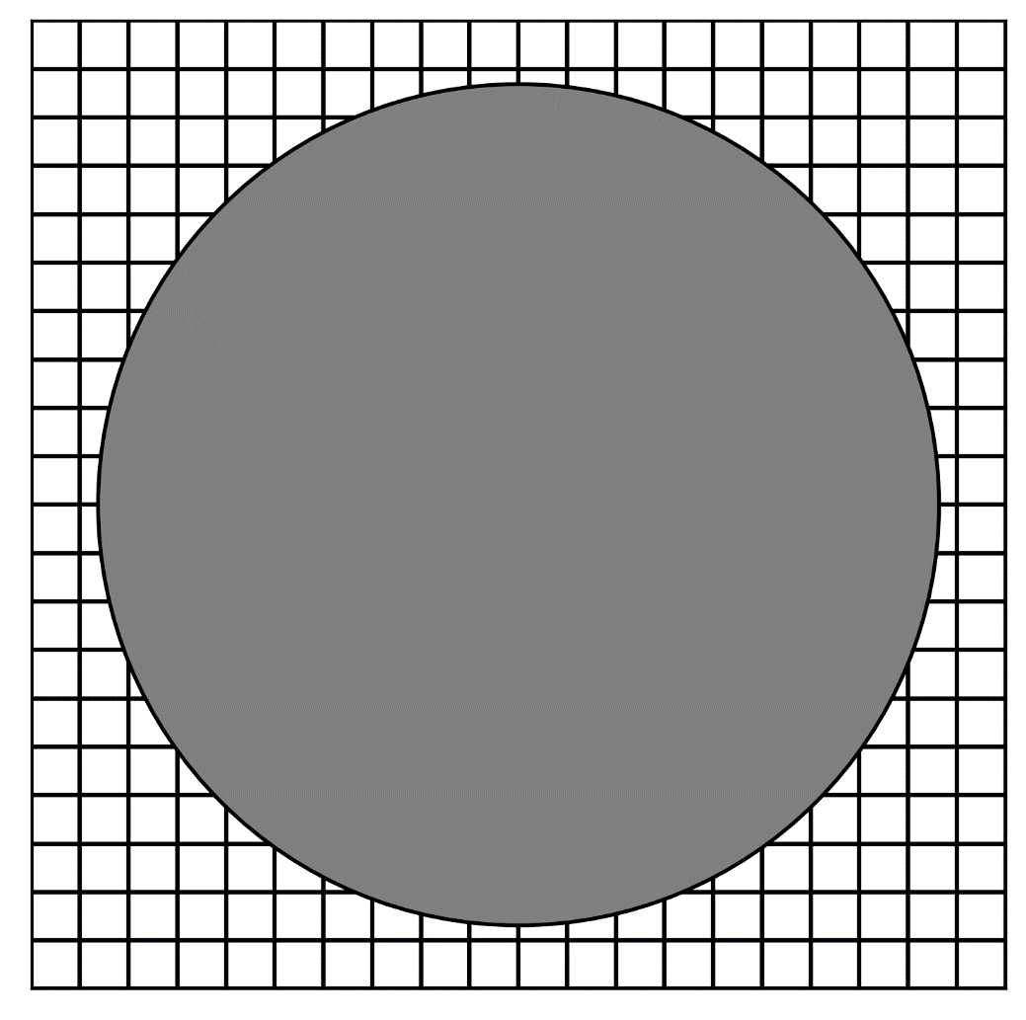
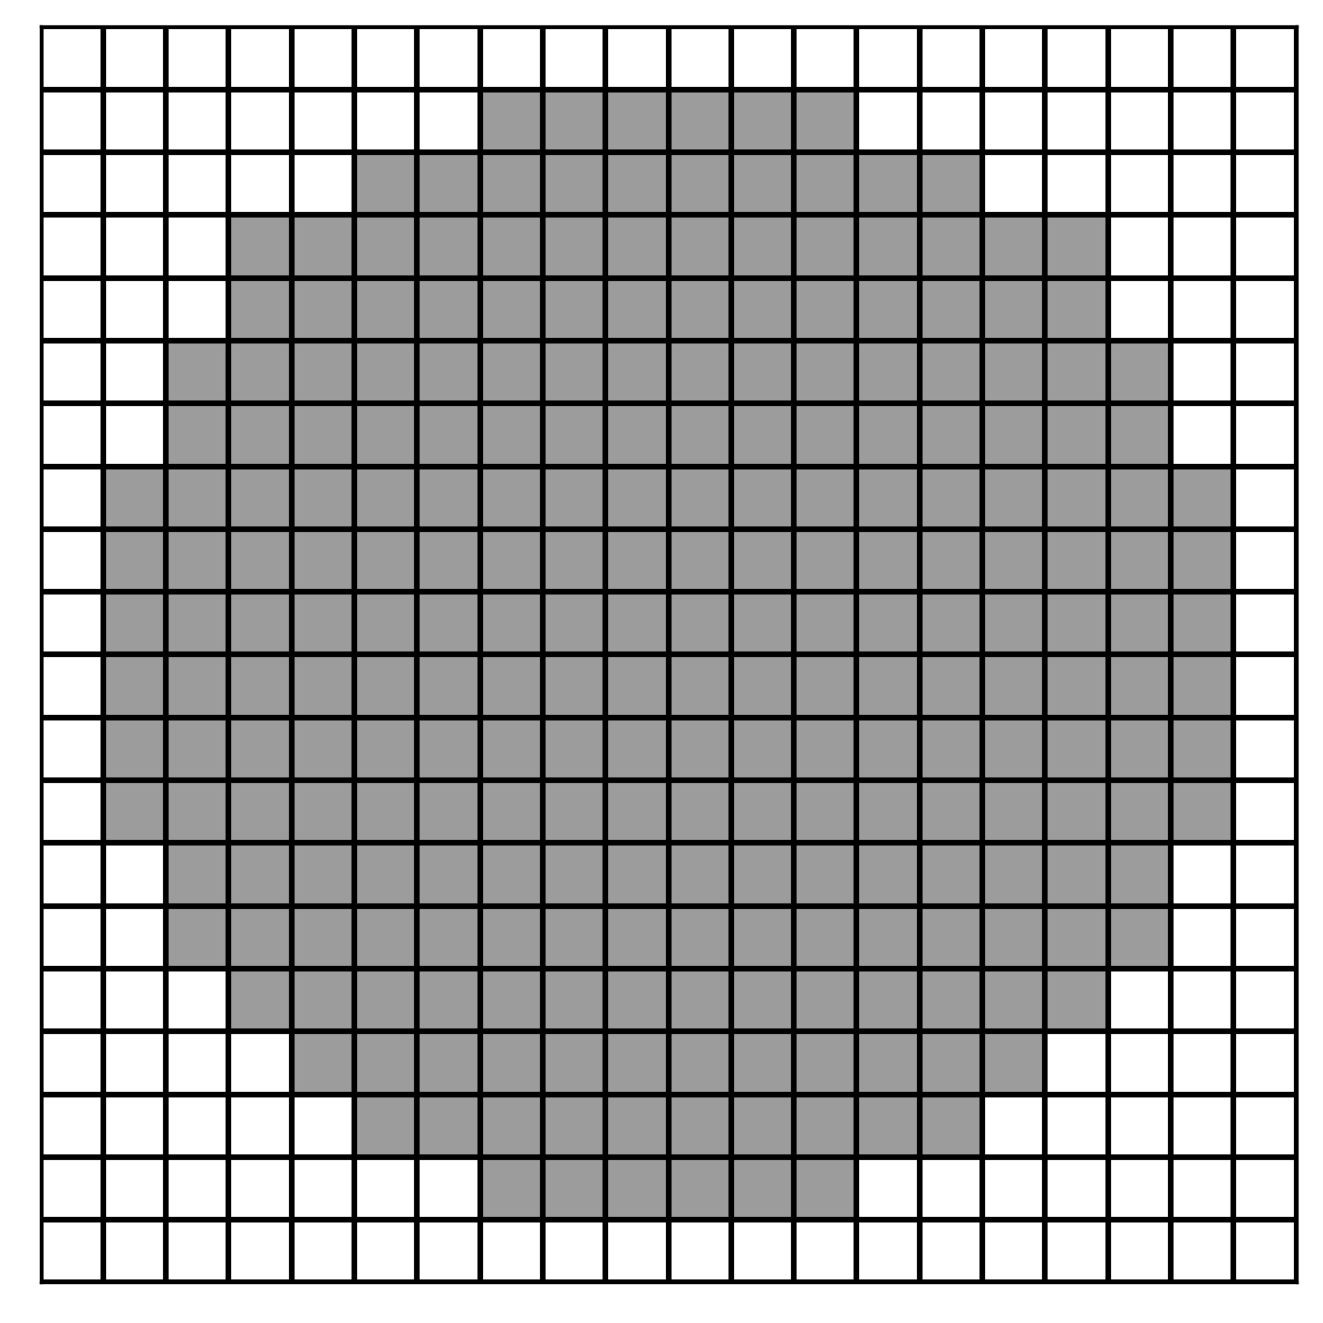


Rasterization
GitHub: https://github.com/jerryweihuajing/Post-Processing

Slide 10
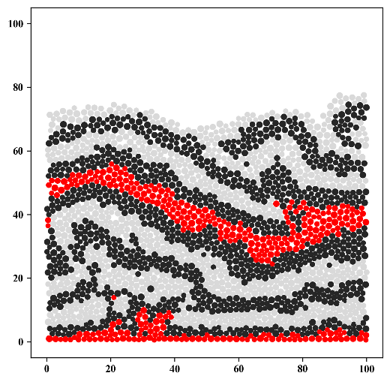
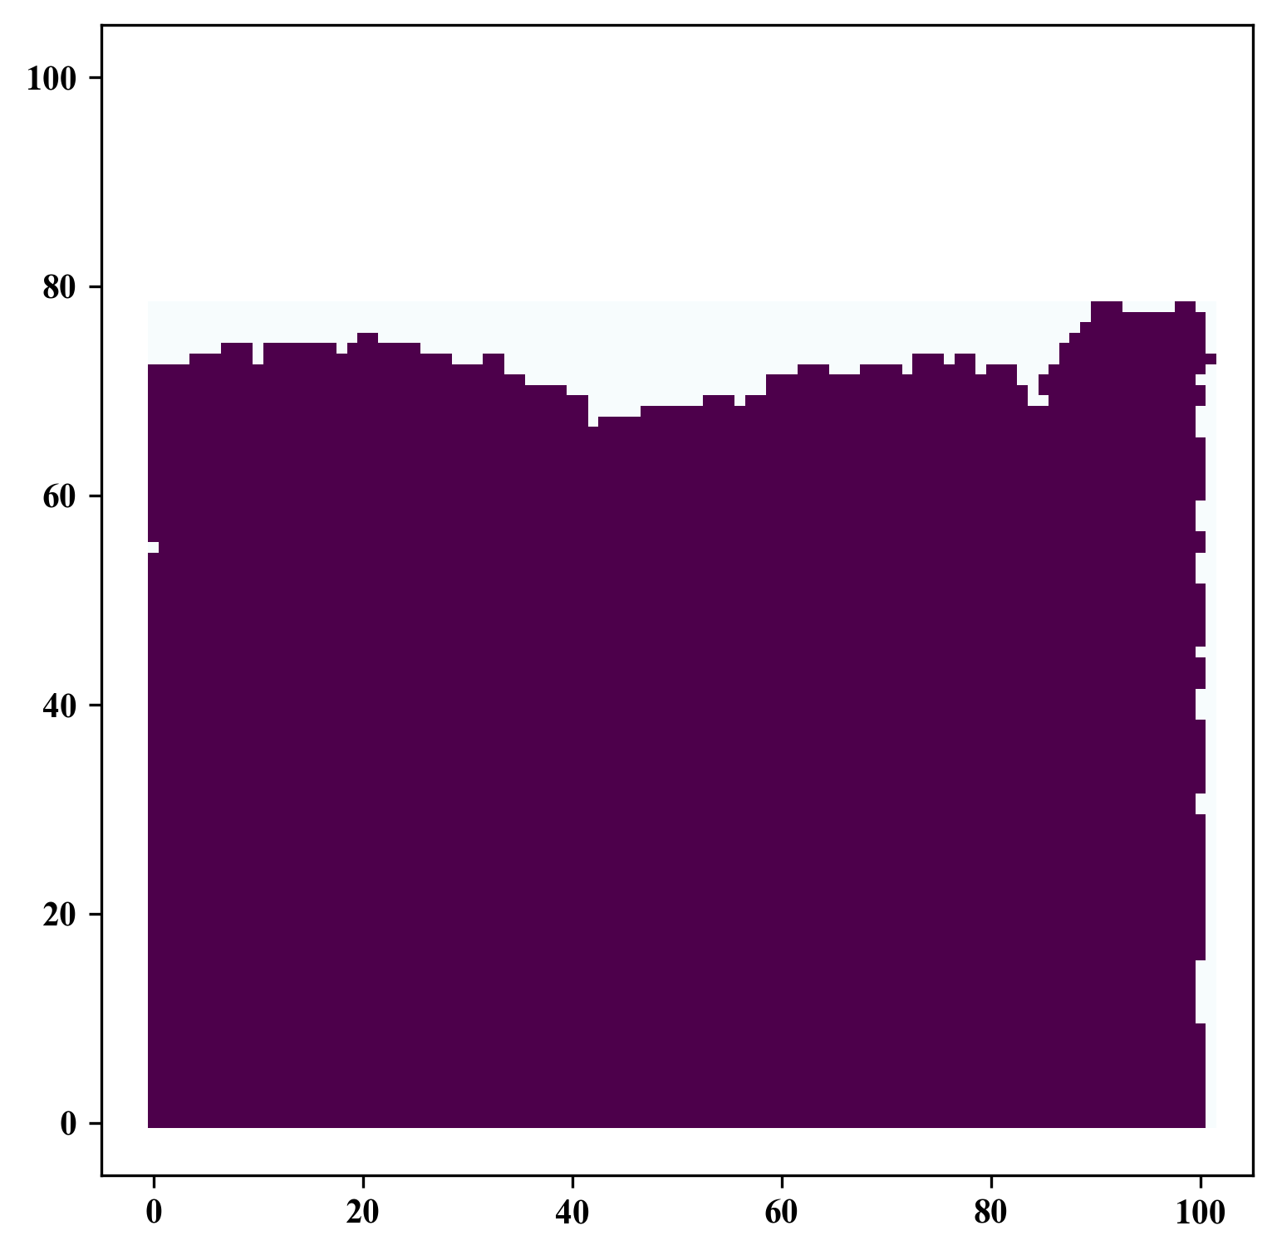
Rasterization
GitHub: https://github.com/jerryweihuajing/Post-Processing

Slide 11
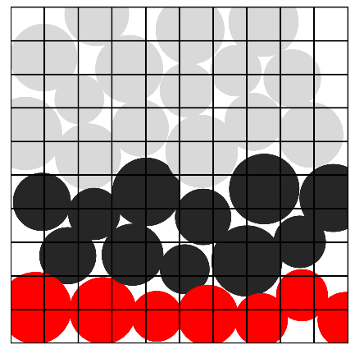
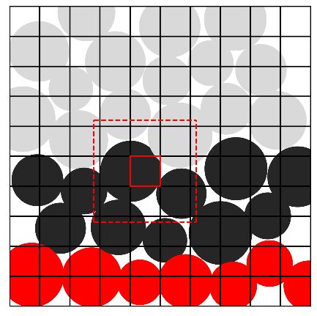
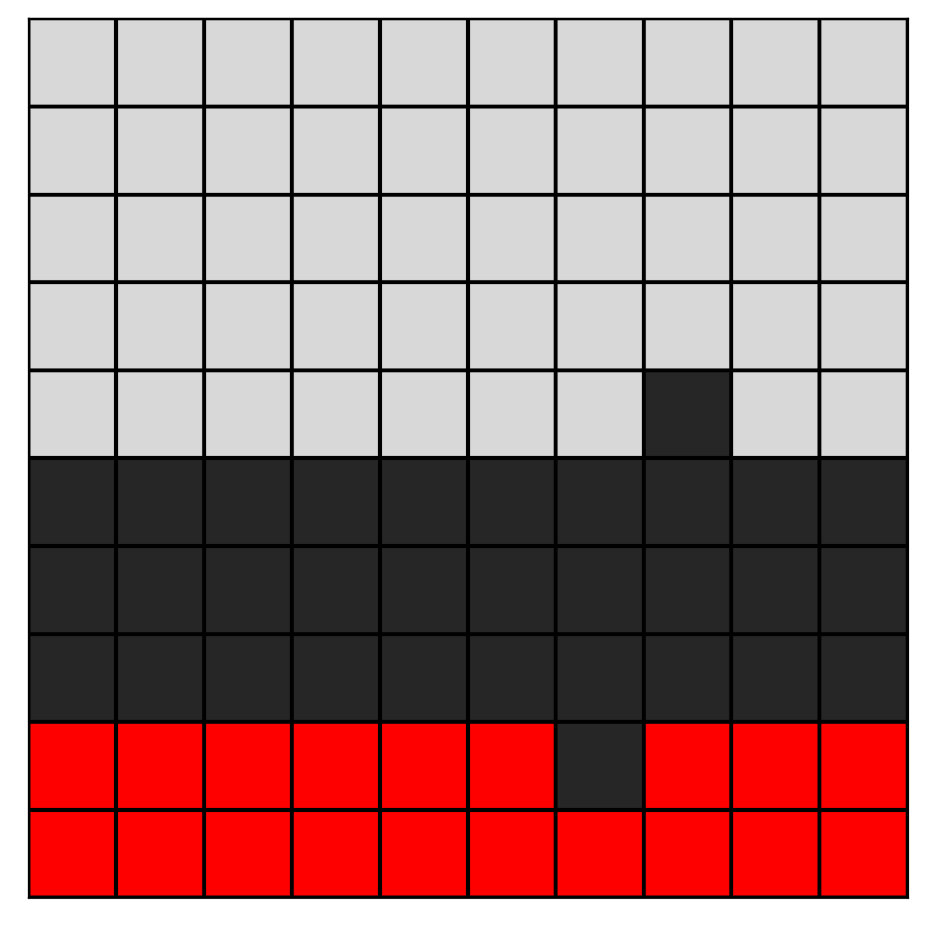
Rasterization
GitHub: https://github.com/jerryweihuajing/Post-Processing

Slide 12

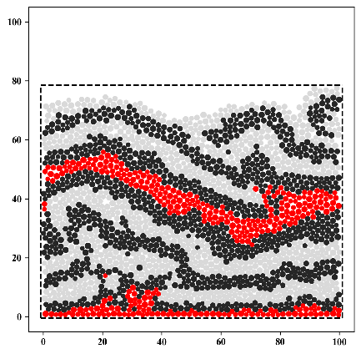
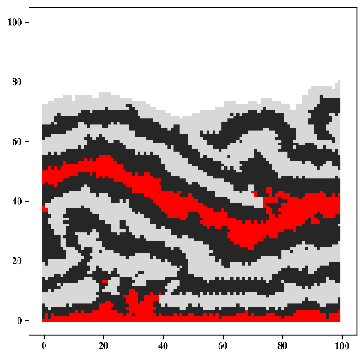
Rasterization
GitHub: https://github.com/jerryweihuajing/Post-Processing

Slide 13
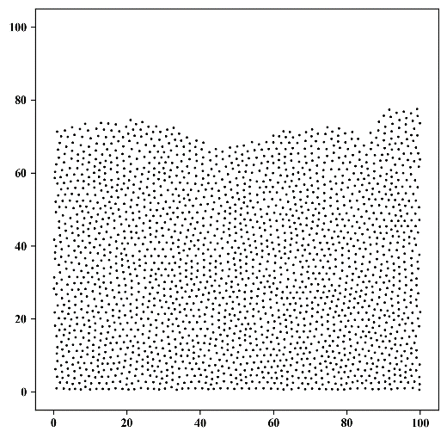
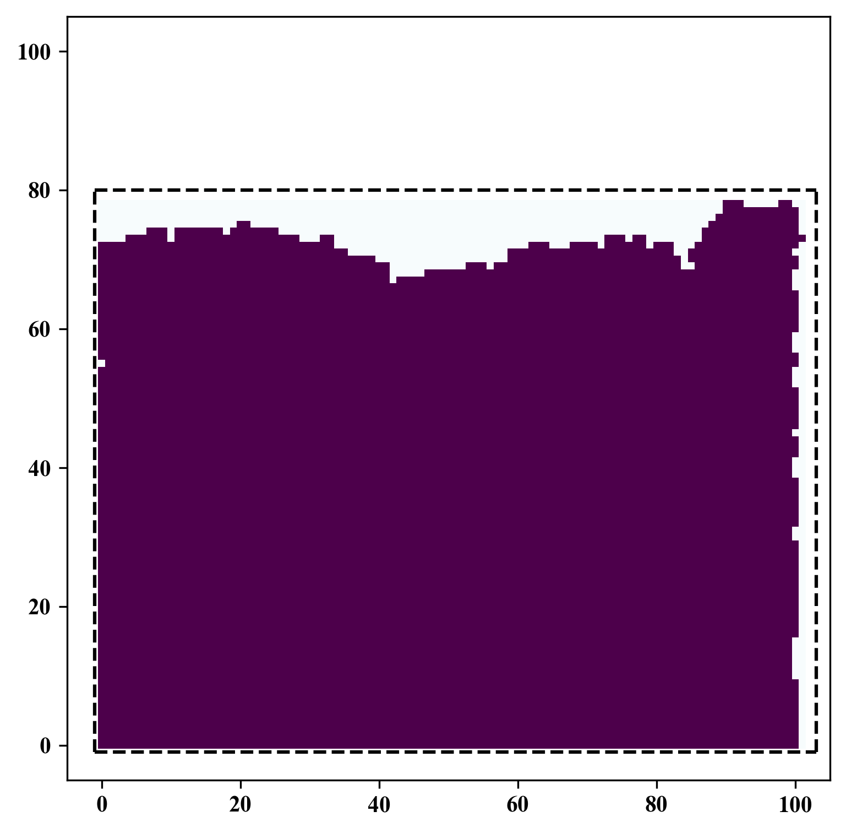
Spatial Interpolation
GitHub: https://github.com/jerryweihuajing/Post-Processing

Slide 14
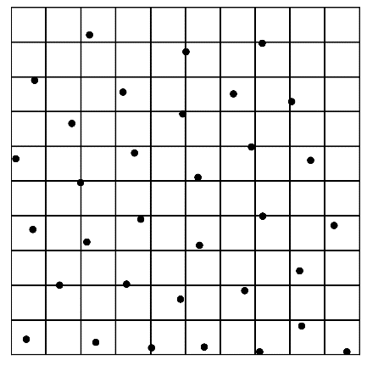
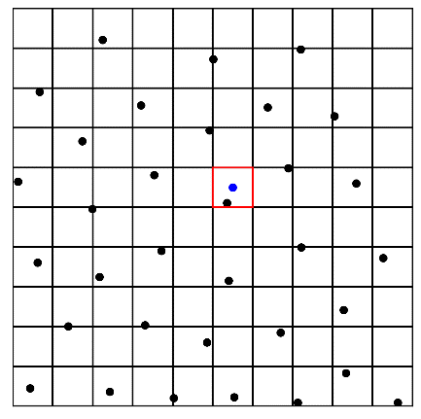
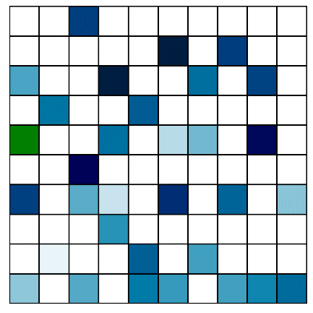
Spatial Interpolation
GitHub: https://github.com/jerryweihuajing/Post-Processing

Slide 15
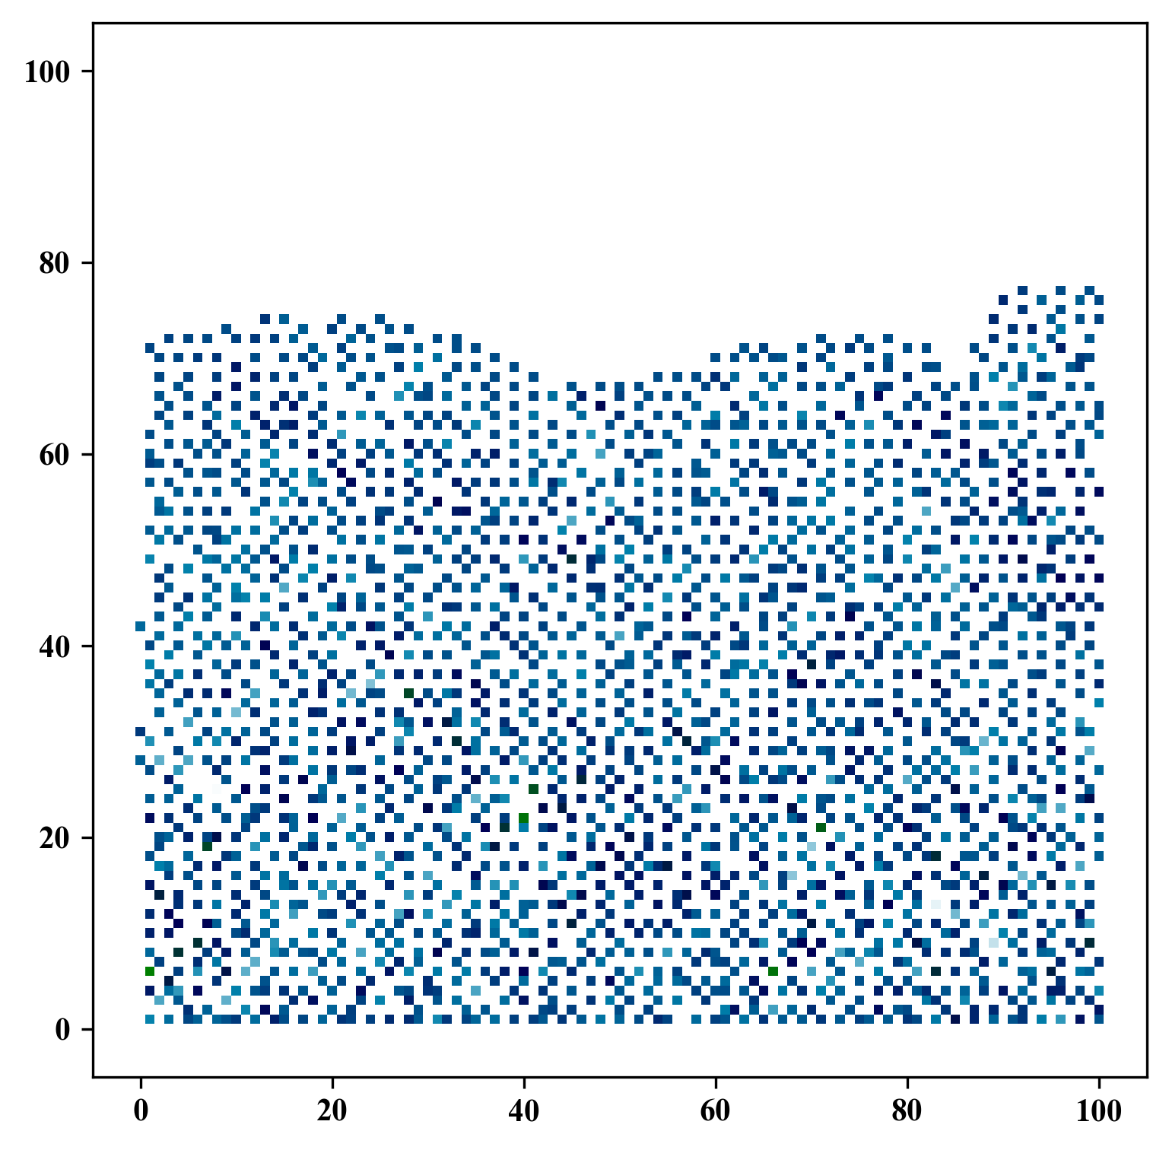
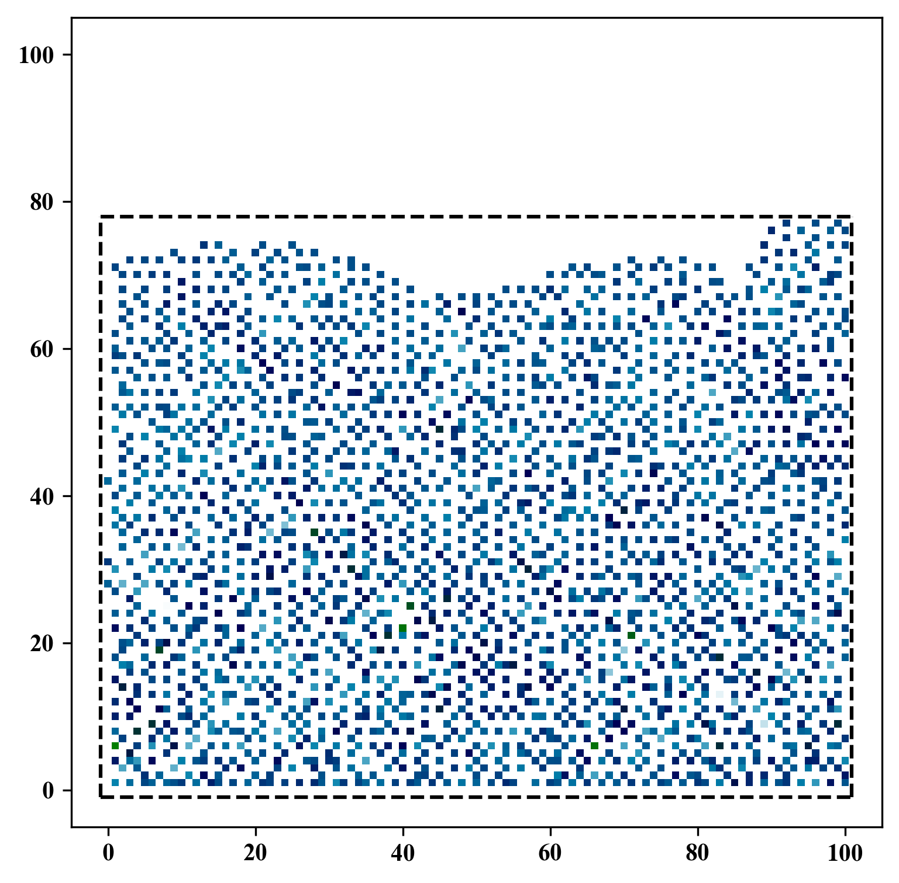
Spatial Interpolation
GitHub: https://github.com/jerryweihuajing/Post-Processing

Slide 16
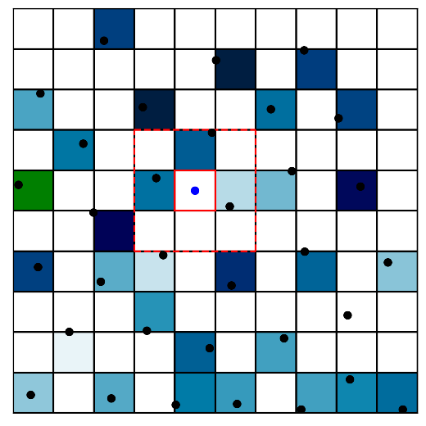
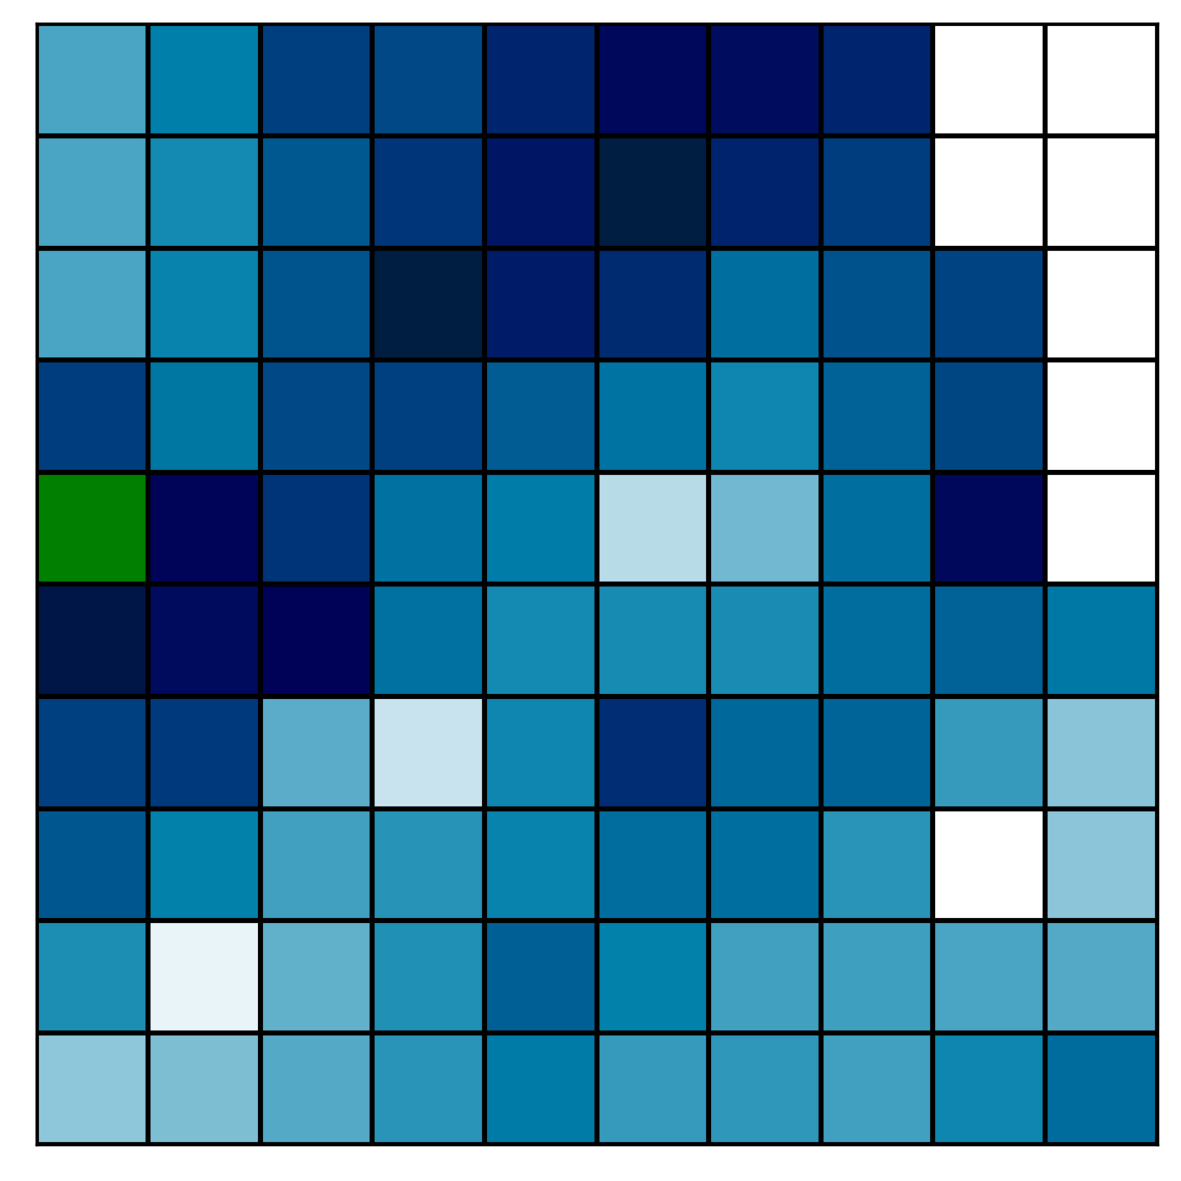
Spatial Interpolation
GitHub: https://github.com/jerryweihuajing/Post-Processing

Slide 17
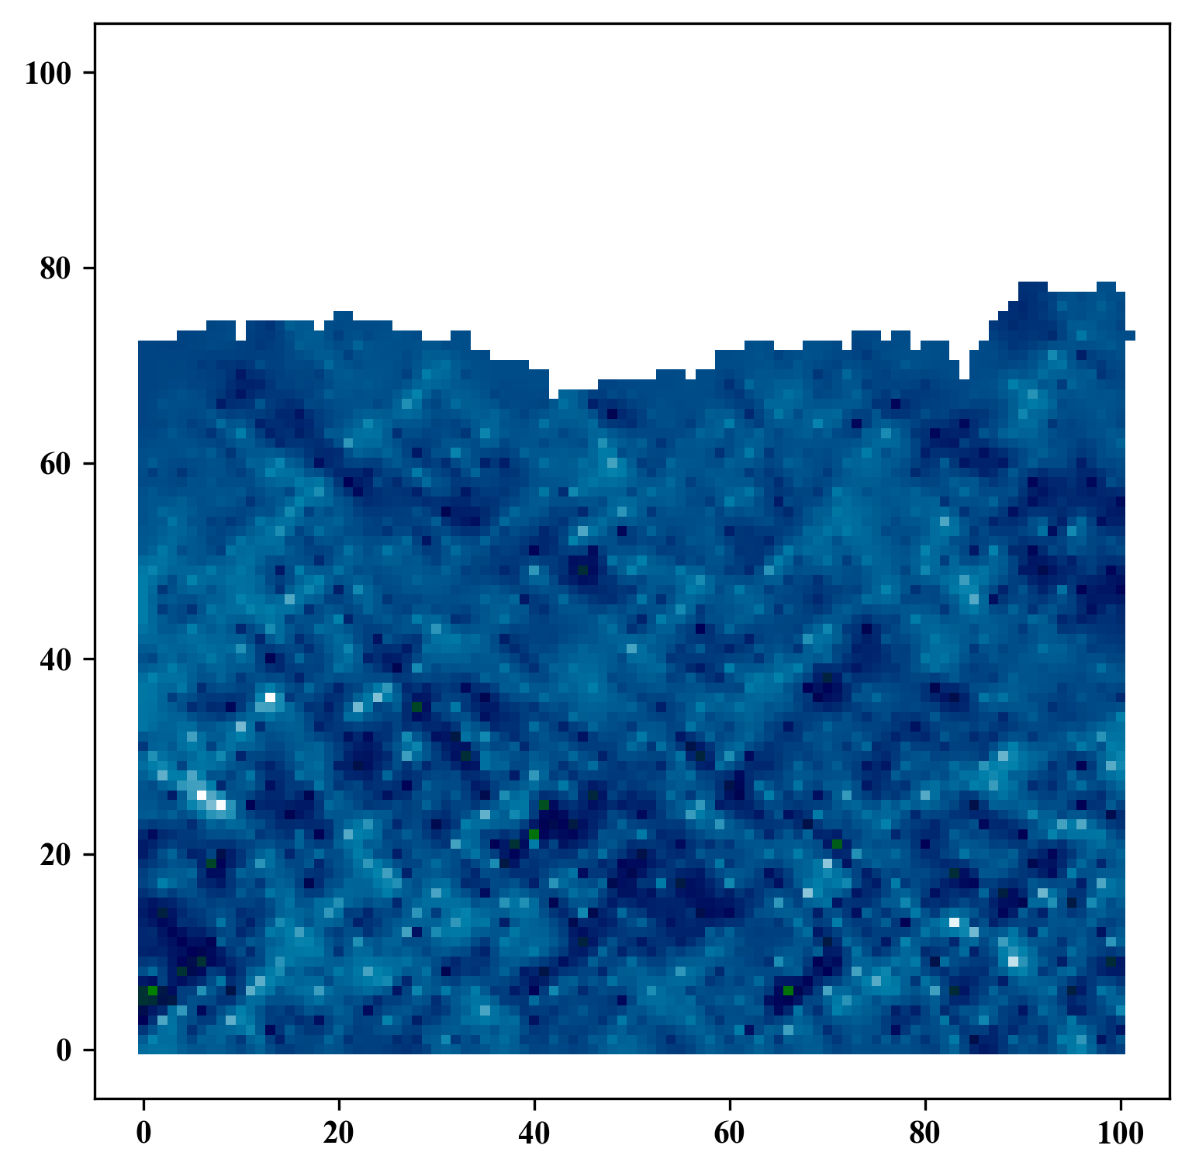
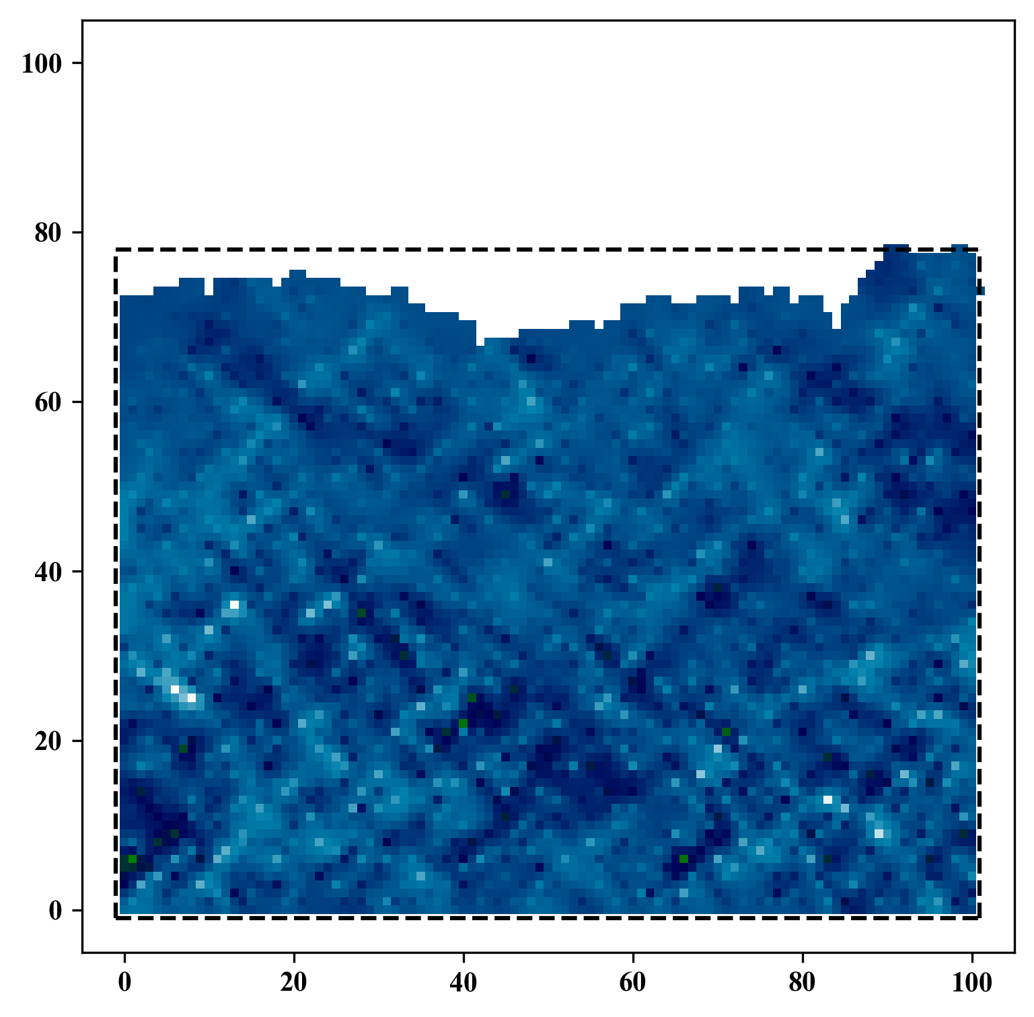
Spatial Interpolation
GitHub: https://github.com/jerryweihuajing/Post-Processing

Slide 18
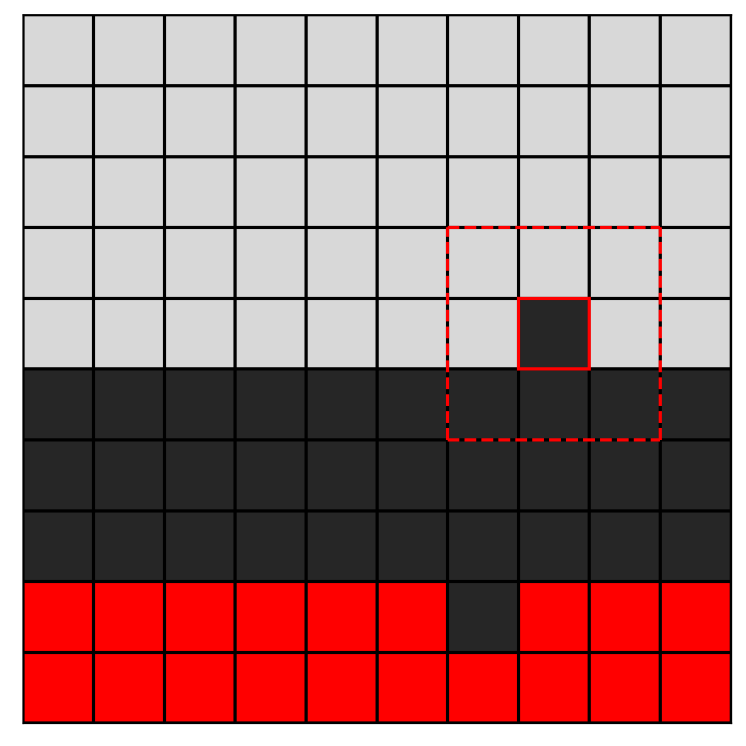
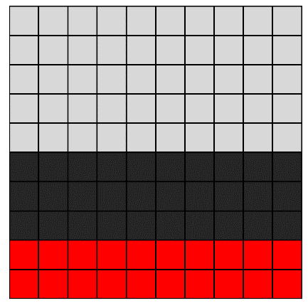
Gaussian Filtering
GitHub: https://github.com/jerryweihuajing/Post-Processing

Slide 19

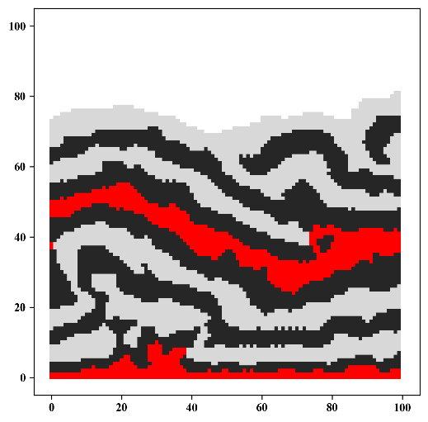
Gaussian Filtering
GitHub: https://github.com/jerryweihuajing/Post-Processing

Slide 20
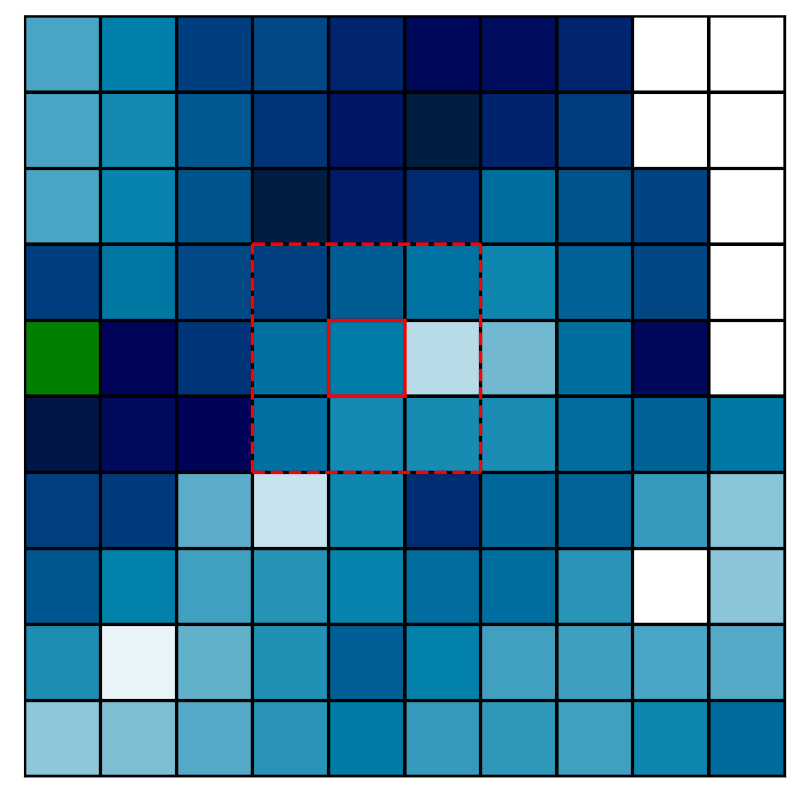
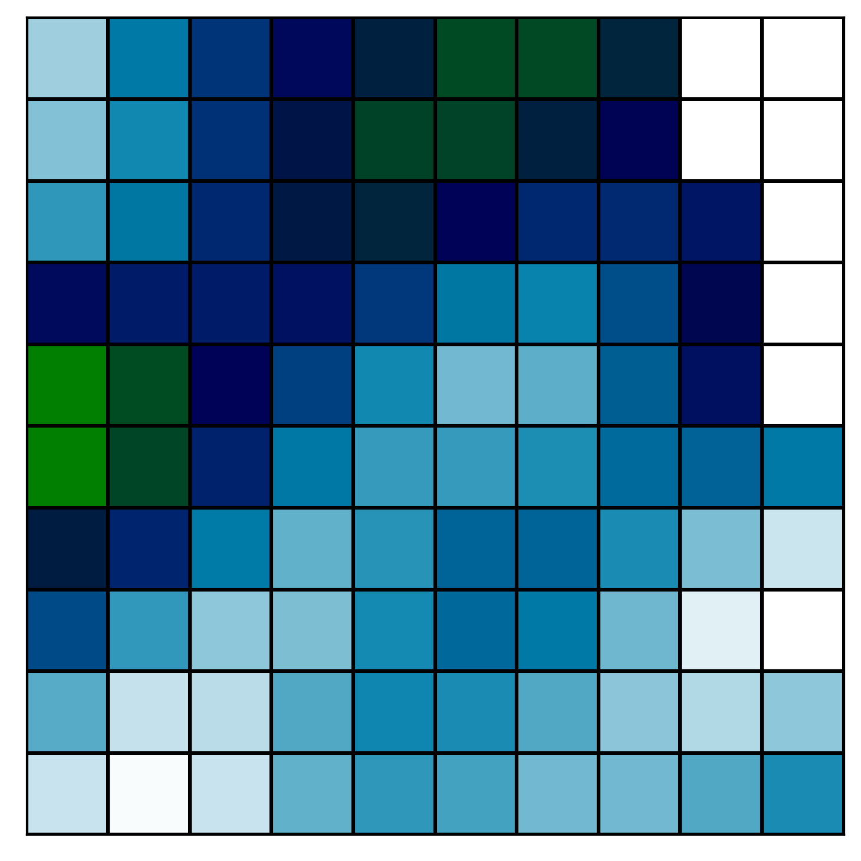
Gaussian Filtering
GitHub: https://github.com/jerryweihuajing/Post-Processing

Slide 21
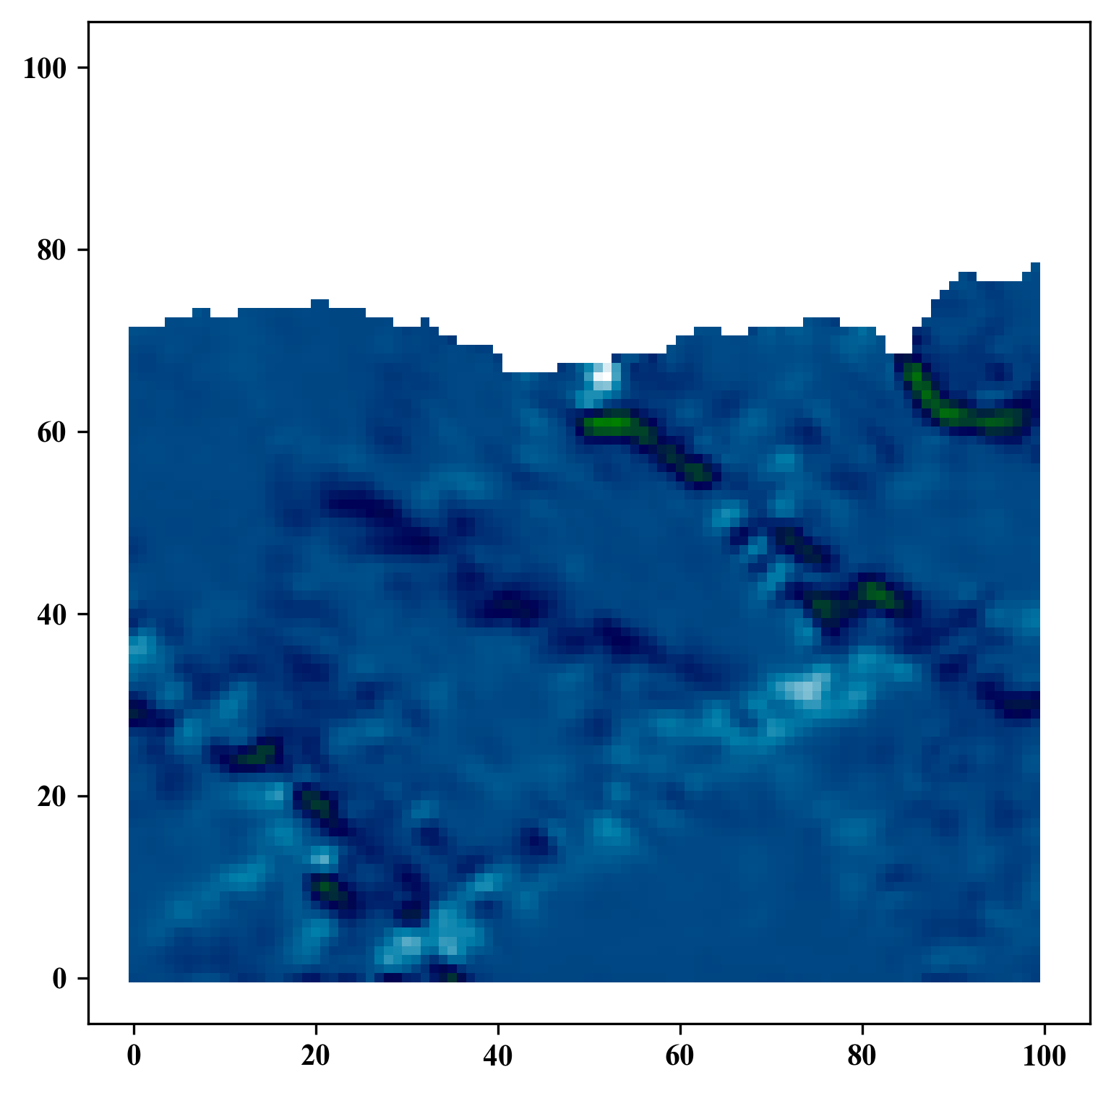
Gaussian Filtering
GitHub: https://github.com/jerryweihuajing/Post-Processing

Slide 22
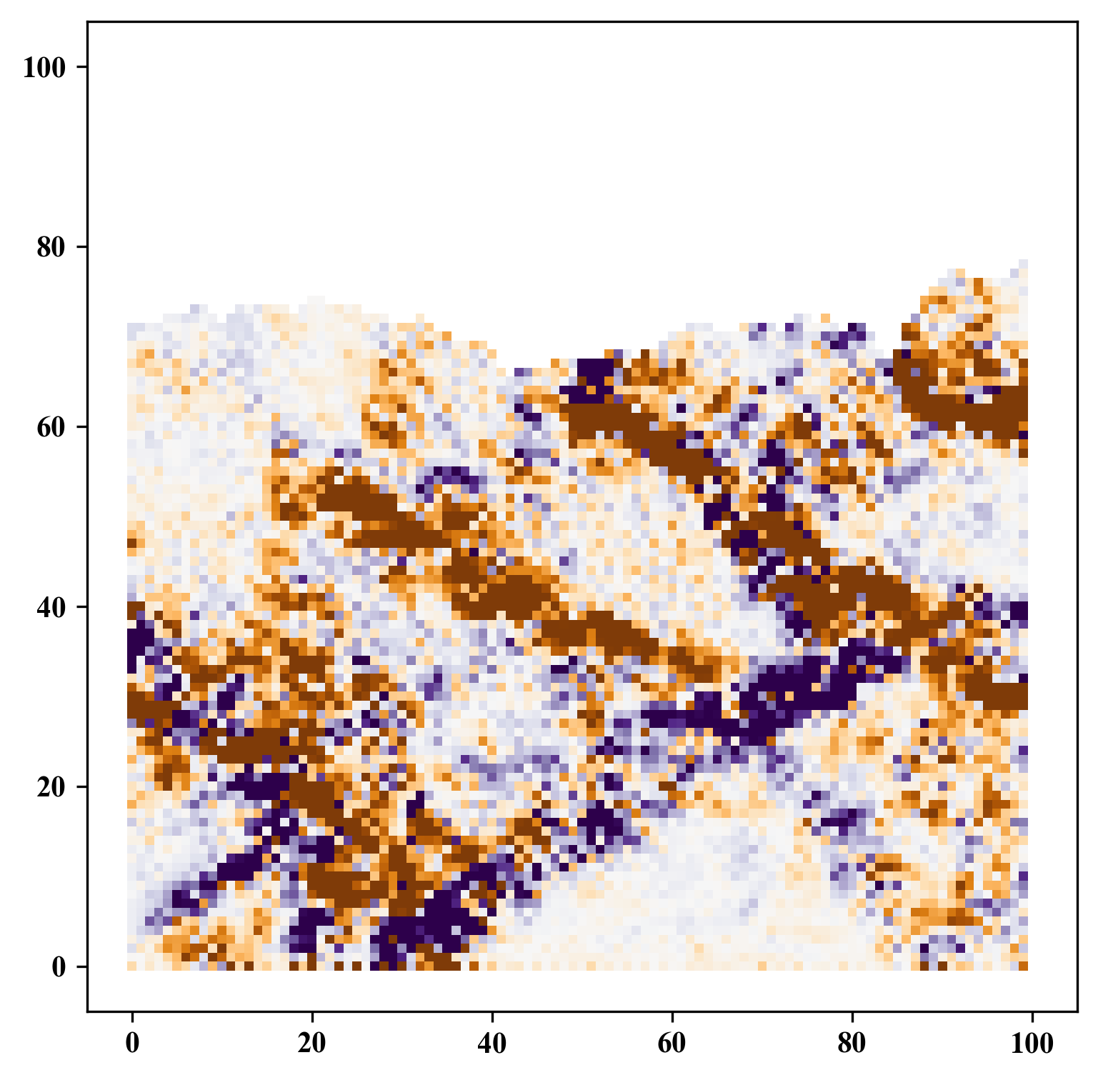
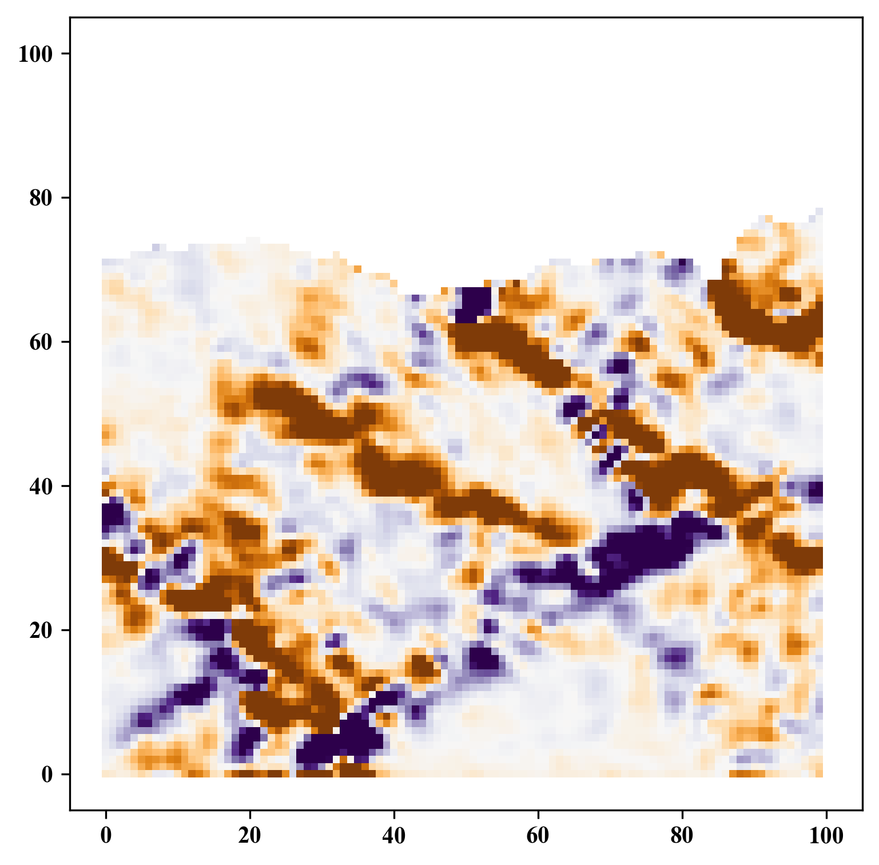
Gaussian Filtering
GitHub: https://github.com/jerryweihuajing/Post-Processing

Slide 23
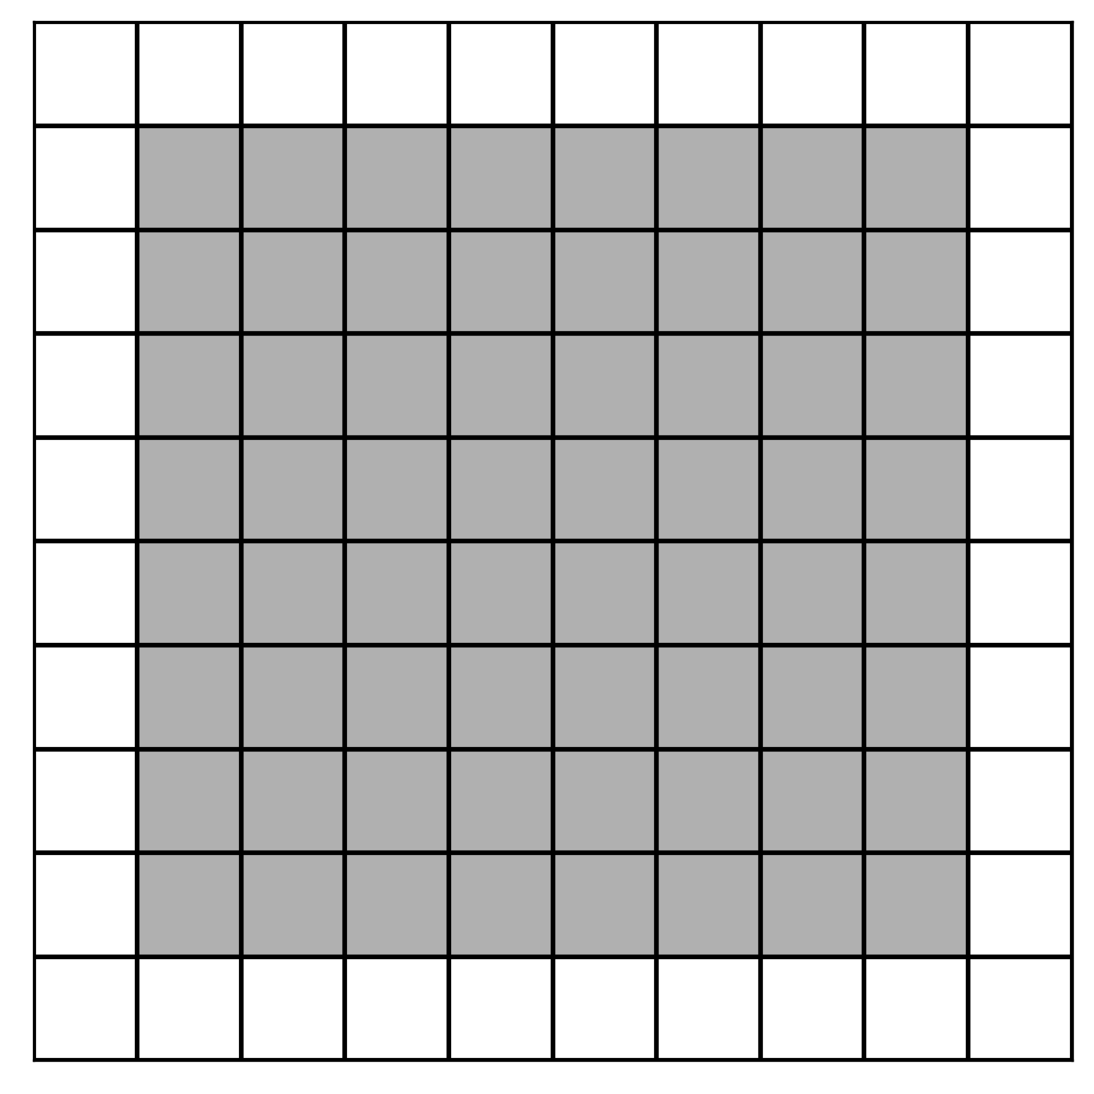
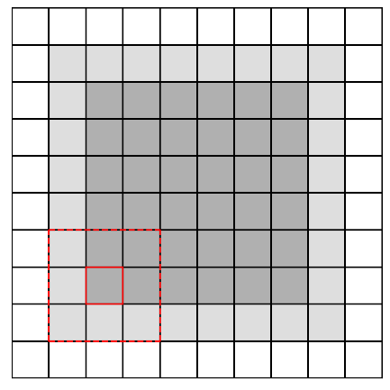
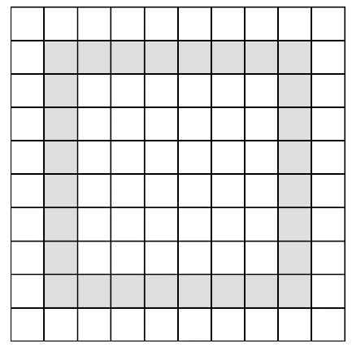
Boundary Extraction
GitHub: https://github.com/jerryweihuajing/Post-Processing

Slide 24
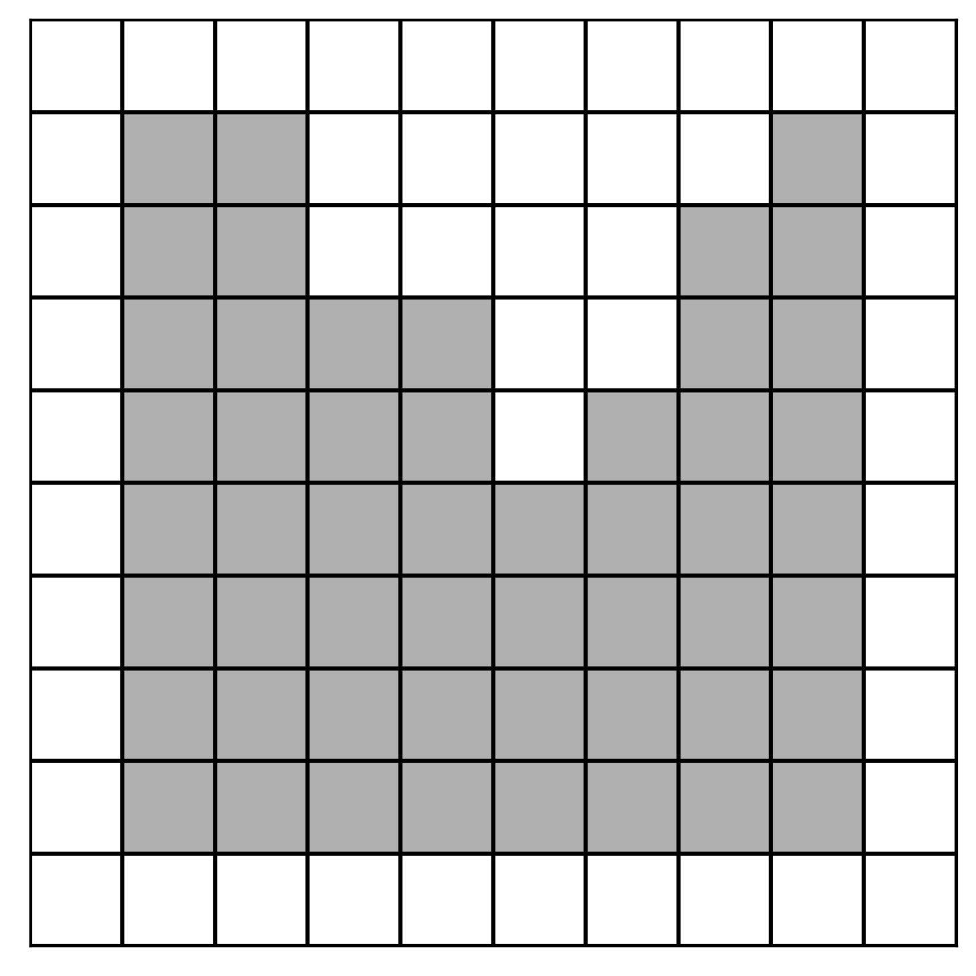
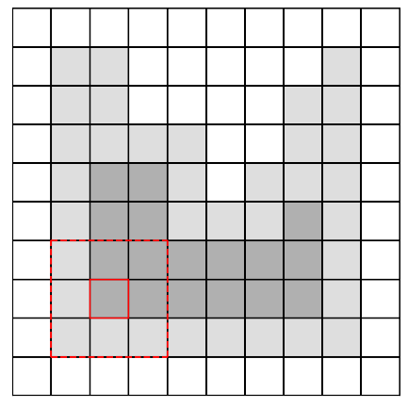
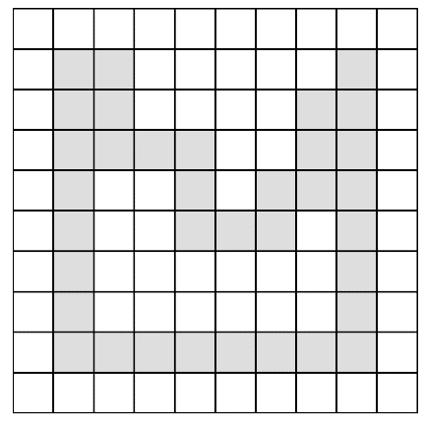
Boundary Extraction
GitHub: https://github.com/jerryweihuajing/Post-Processing

Slide 25
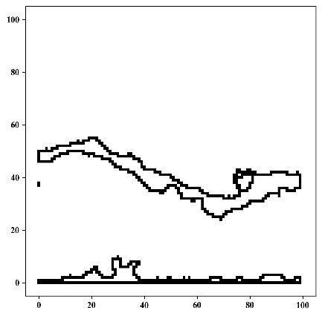
Boundary Extraction
GitHub: https://github.com/jerryweihuajing/Post-Processing

Slide 26
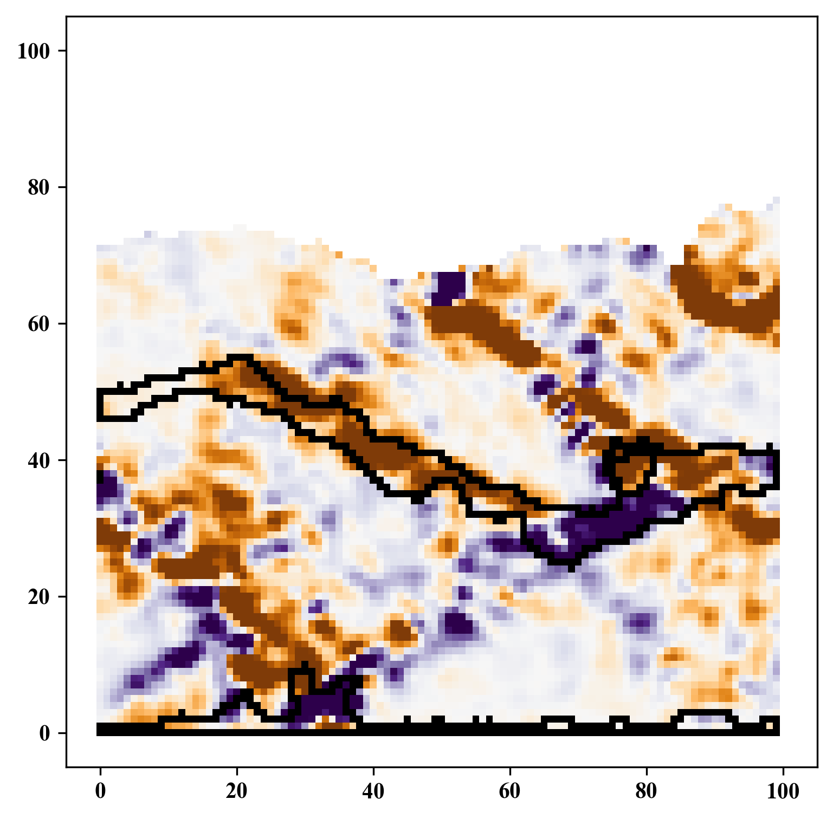
Boundary Extraction
GitHub: https://github.com/jerryweihuajing/Post-Processing

Slide 27
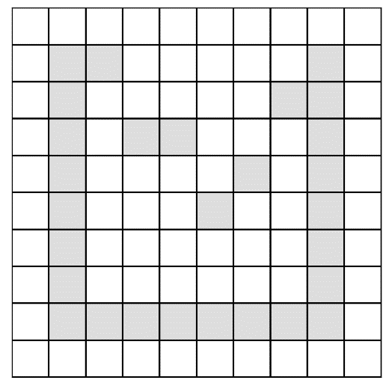
Outline Calculation
GitHub: https://github.com/jerryweihuajing/Post-Processing

Slide 28
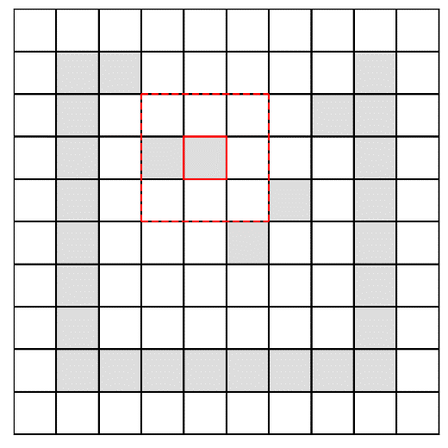
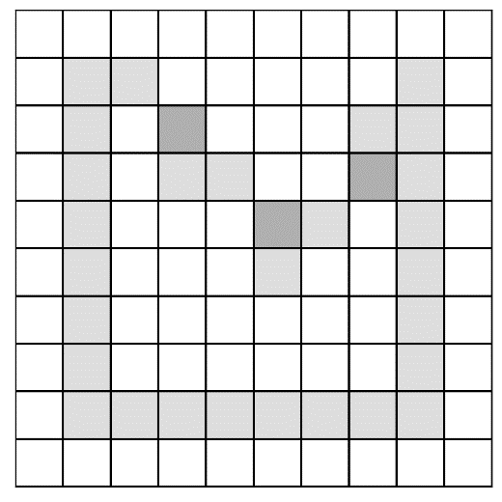
Outline Calculation
GitHub: https://github.com/jerryweihuajing/Post-Processing

Slide 29
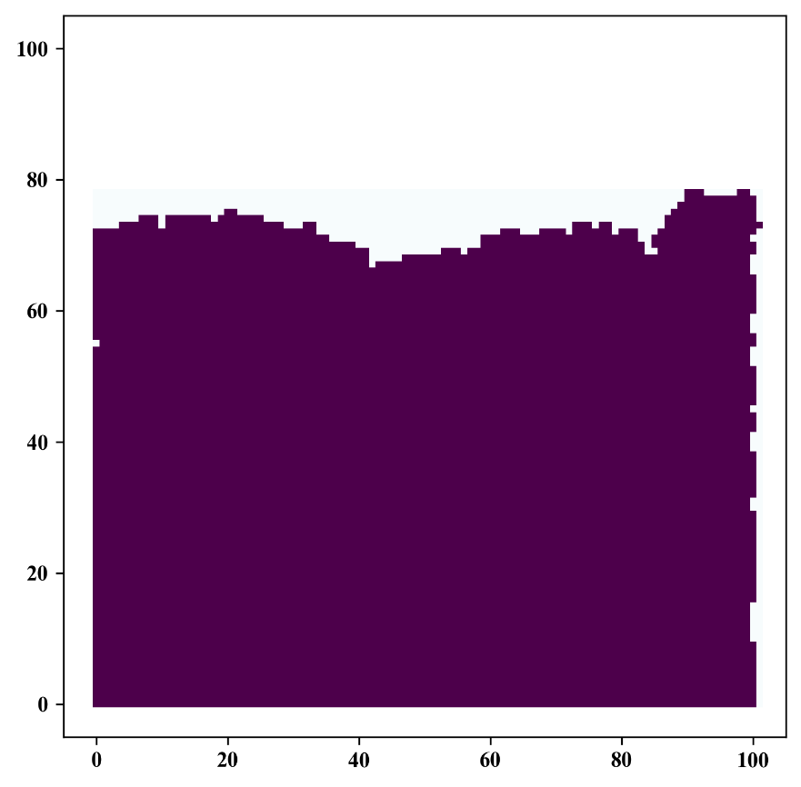
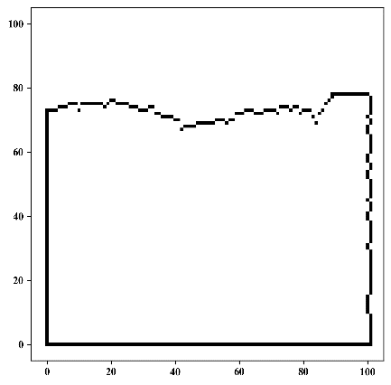
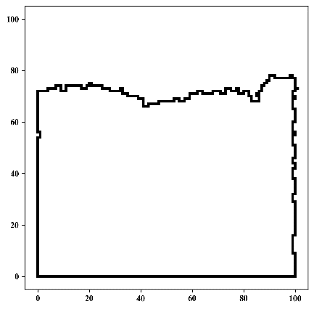
Outline Calculation
GitHub: https://github.com/jerryweihuajing/Post-Processing

Slide 30
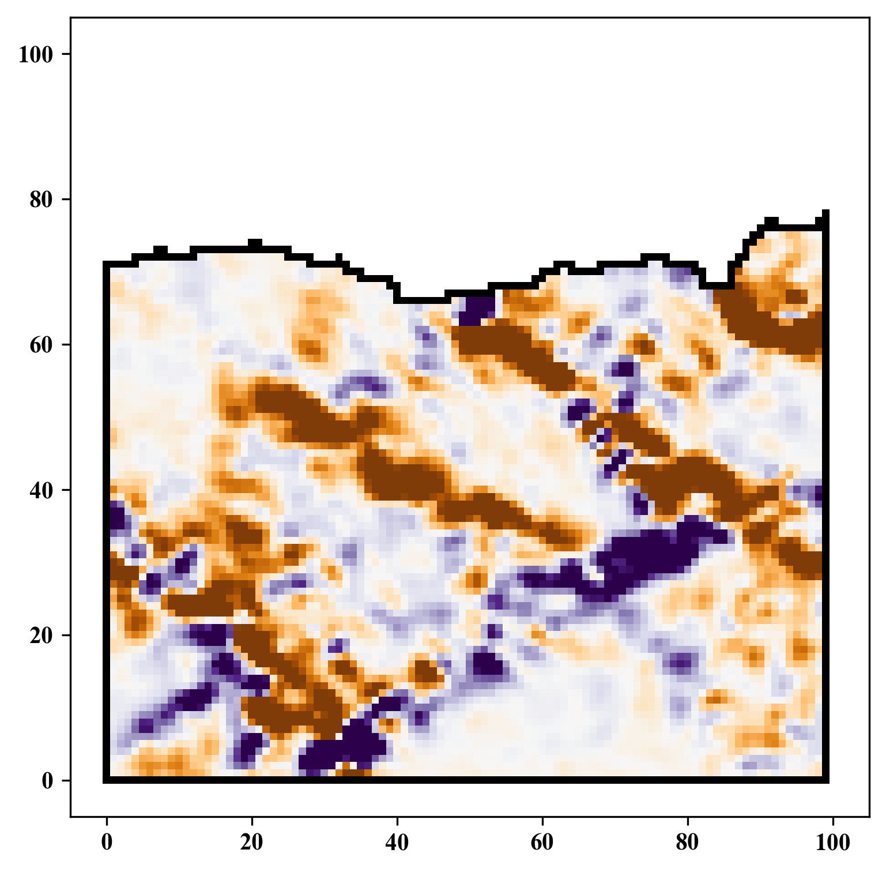
Outline Calculation
GitHub: https://github.com/jerryweihuajing/Post-Processing

Slide 31
Content
Introduction
Algorithm
Example
Experiment
Conclusion

Slide 32
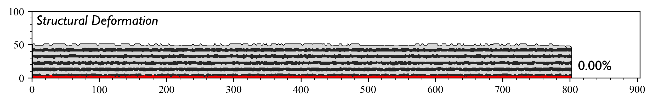
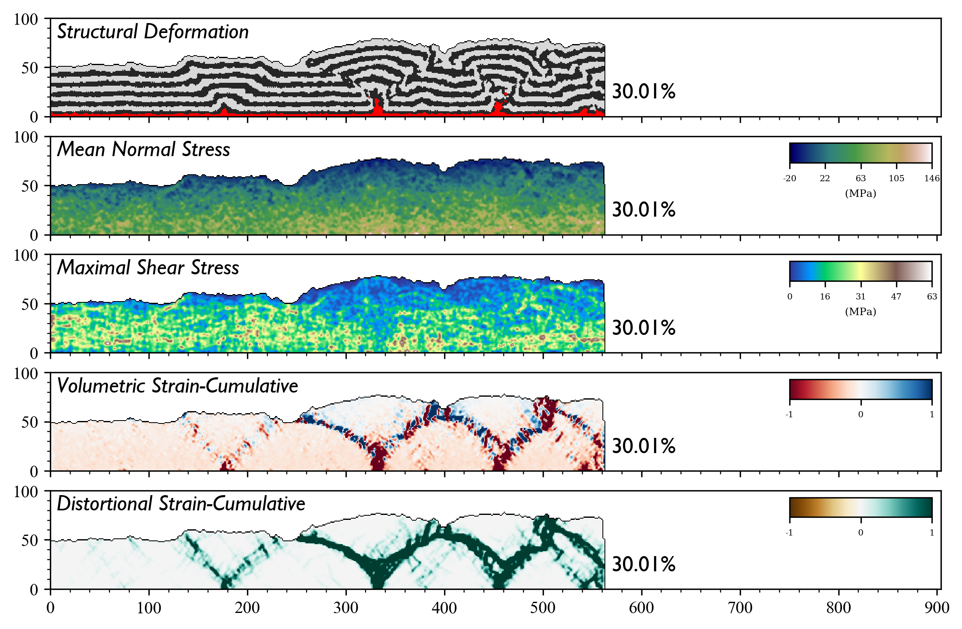
Base

Slide 33
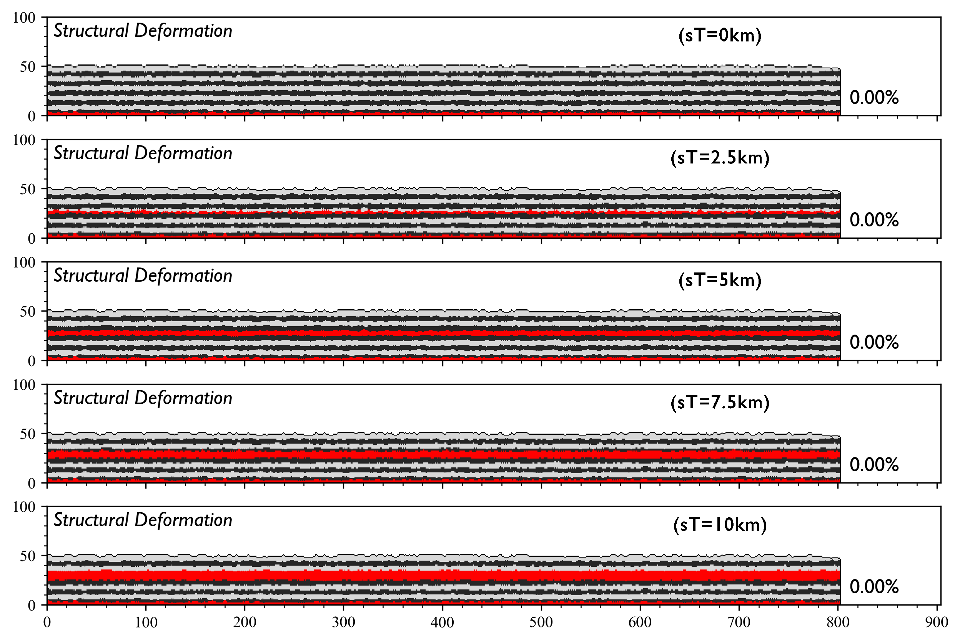

Salt Thickness

Slide 34


Salt Thickness

Slide 35




Salt Width

Slide 36




Salt(far away) Width

Slide 37




Salt Depth

Slide 38




Salt Offset

Slide 39




Fault Orientation

Slide 40




Fault Inclination(+)

Slide 41




Fault Inclination(-)

Slide 42




Fault Depth(+)

Slide 43




Fault Depth(-)

Slide 44


Fault Offset(+)

Slide 45


Fault Offset(+)

Slide 46


Fault Offset(-)

Slide 47


Fault Offset(-)

Slide 48




Fault Scale-from Bottom(+)

Slide 49




Fault Scale-from Bottom(-)

Slide 50




Fault Scale-from Surface(+)

Slide 51




Fault Scale-from Surface(-)

Slide 52
Conclusion

Slide 53
Acknowledgement
THANKS

